Slide 1
UNIT IV
Flow Control, Error Detection & Correction, CSMA, CSMA/CD, HDLC and PPP

Slide 2
Agenda
Framing, Flow Control Mechanisms
Stop Wait Protocol
Goback N ARQ, Selective Reject ARQ
CRC, Checksum
Types of Errors
Error Correction
CSMA, CSMA/CD
HDLC
PPP

Slide 3
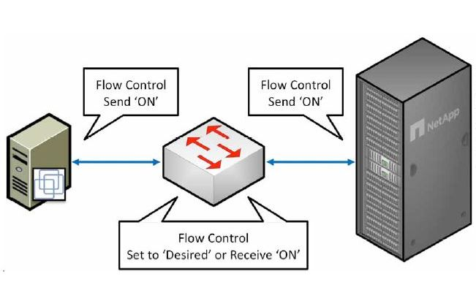
Flow & Error Control

Slide 4
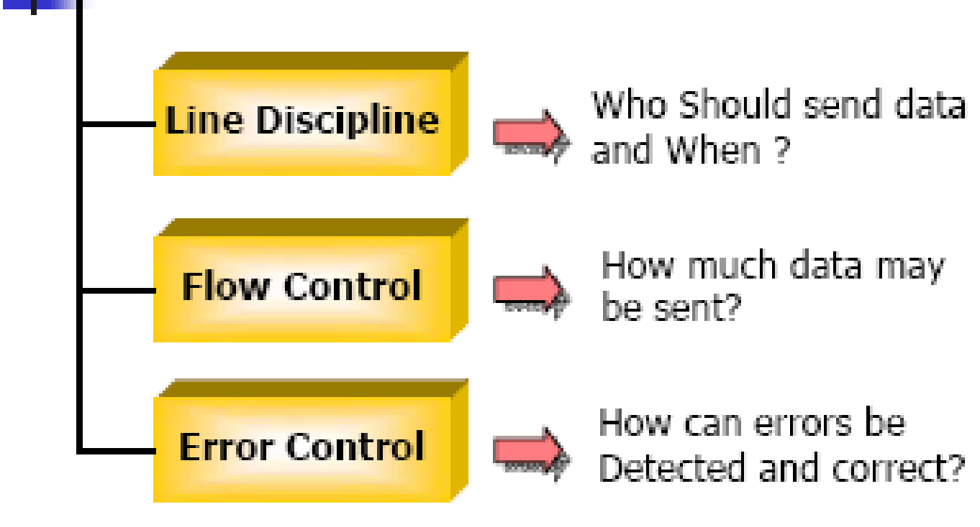
Data Link Control
Line Discipline: Determines which device can send and when it can send
Flow Control: Coordinates the amount of data that can be sent before receiving acknowledgement. Linked with error control
Error Control: Allows the receiver to inform the sender of any frames lost or damaged in transmission and coordinates retransmission of those frames by the sender

Slide 5
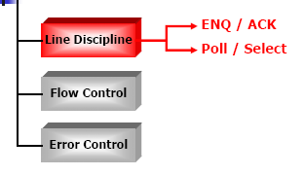
Line Discipline
In Line discipline whatever the system is, no device should be allowed to transmit until that device has evidence that the intended receiver is ready to receive the transmission
Line discipline can be done in two ways:
Enquiry/Acknowledgment (ENQ/ACK)
Poll/Select

Slide 6
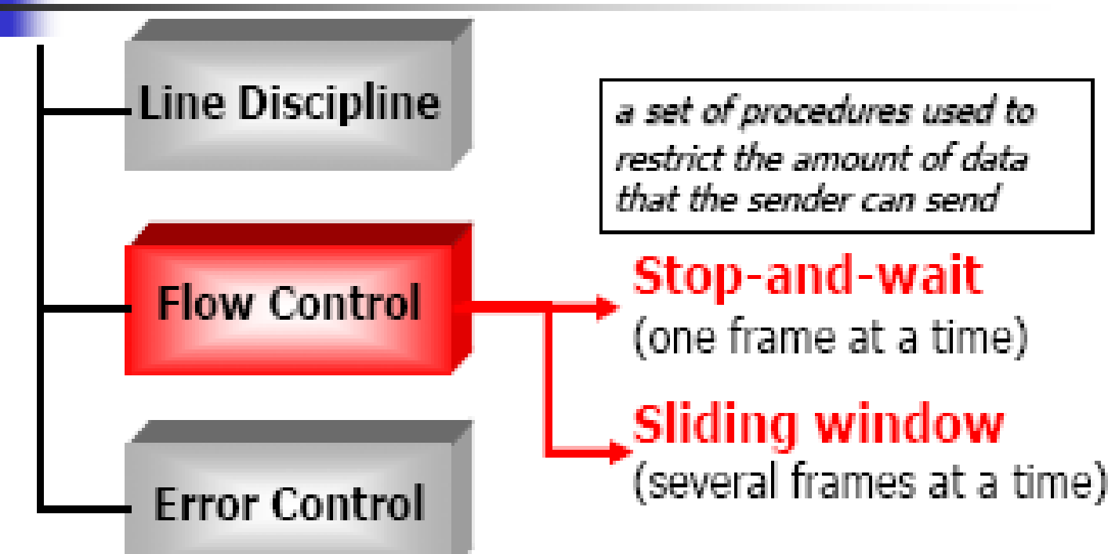
Flow Control
Second aspect of Data link control- Flow Control
Set of procedures that tells the sender as how much data it can transmit before waiting for an acknowledgment from the receiver.
Receiver got set of memory blocks called the BUFFER that store the incoming data before they are processed.
If buffer begins to fill up, receiver must be able to tell the sender to send fewer data frames or halt the transmission until the buffer is free to accept the data frame again.
Under this we got two techniques:
Stop- and Wait
Sliding Window

Slide 7
Stop and Wait
In stop- and- wait flow control, the sender waits for an acknowledgment after every data frame it sends.
Only when acknowledgement has been received, the next data frame is sent.
The process of alternatively sending and waiting repeats until the sender transmits an end of transmission frame
Advantage: of stop and wait flow control is simplicity as each frame is checked and acknowledged before transmitting next frame
Disadvantage: It is very slow as each frame must travel all the way to the receiver and acknowledgement must travel all the way back before the next frame can be sent.
If distance between the devices are too long, time spent waiting for ACKs between each frame can add to the transmission time.

Slide 8
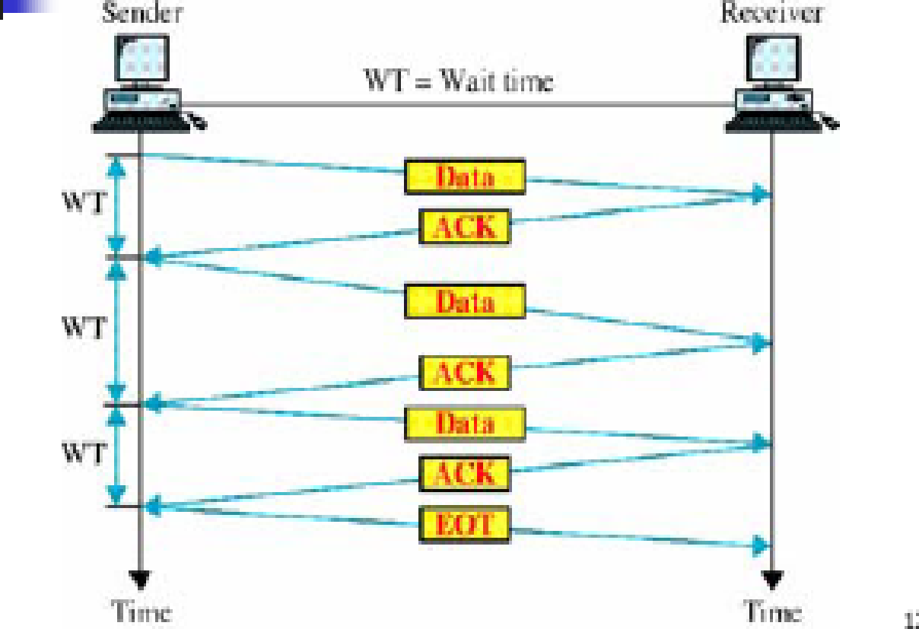

Slide 9
Sliding Window
In Sliding window, the sender can transmit several data frames before needing an acknowledgment
Frames can be sent one after another i.e. link can carry several frames at once and its capacity can be used efficiently
The receiver acknowledges only some of the frames using a simple ACK to confirm the receipt of multiple data frames
Sliding window is like an imaginary boxes at both the sender and receiver side
These windows can hold the data frames and provides the upper limit on the number of data frames that can be transmitted before receiving an acknowledgement.

Slide 10
Frames may be transmitted to the receiver as long as window is not full.
The frames are numbered 0 to n-1 . For example if n=8, frames are numbered 0,1,2,3,4,5,6,7,0,1,2,3,4,5,6,7,0,1………
The size of the window is n-1. Window always cover n-1 data frames and not n data frames.
When the receiver sends an ACK it can include the number of next frame it is expected to receive. For example when the sender sees an ACK with number 5, it means all frames upto 4 ( 0 to 4) has been received.

Slide 11
Sender Window
At the beginning of transmission sender’s window contains n-1 data frames.
As frames are sent out, left boundary of window moves inward shrinking the size of the window
Given a window size w, if three frames have been transmitted since last ACK, number of frames left in window is w-3
For example say we have a window of size 7. ( 0 to 6)
Say Frames 0 through 3 have been sent and no ACK have been received, sender’s window contains only 4,5 & 6.
Once ACK is received with number 4, then four frames have been received ( 0 through 3) and sender’s window expands to include next four frames in buffer to contain totally 6 frames as 4,5,6,7,0,1,2.
If say received ACK is numbered 2, the sender’s window would have been expanded only by two frames to contain totally 6 as 2,3,4,5,6,7,0 only.

Slide 12
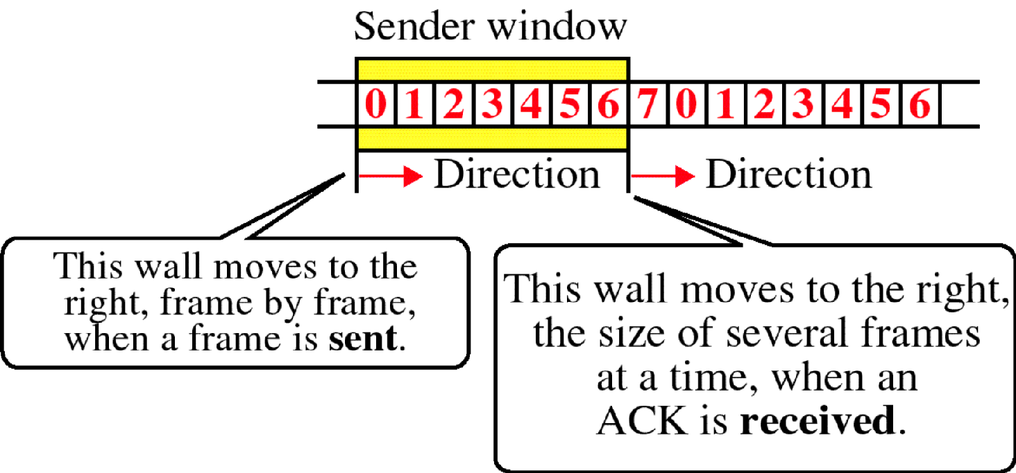
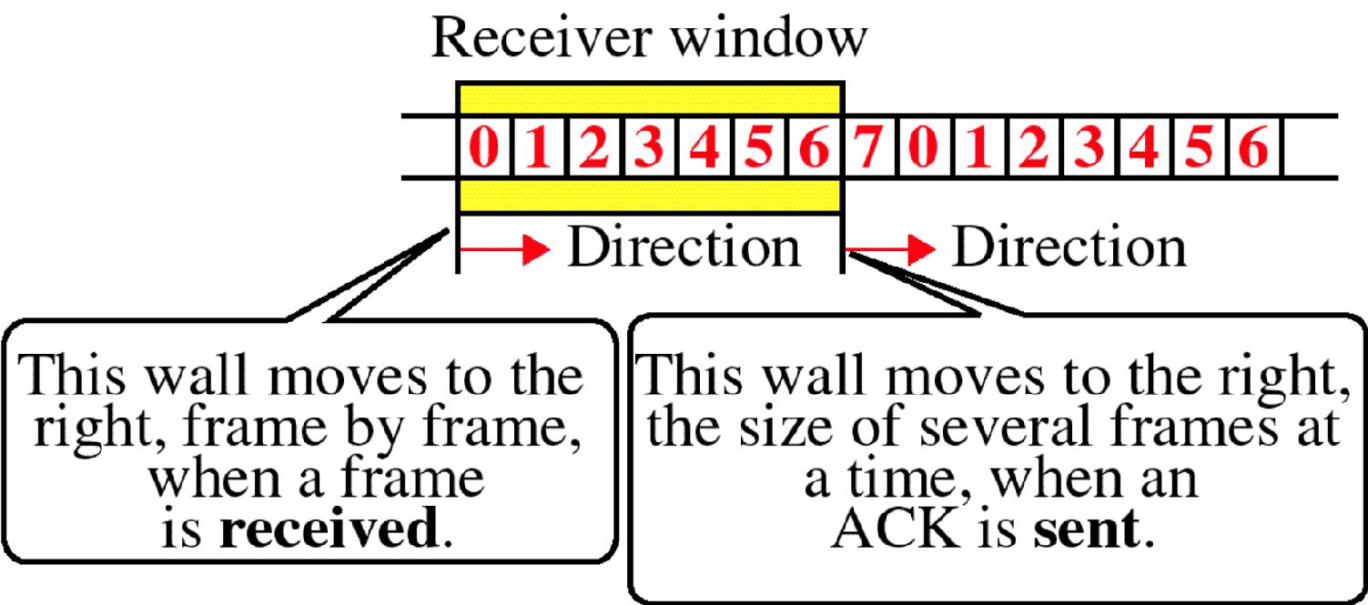
Sender & Receiver Window

Slide 13
Receiver Window
At receiver we got not n-1 data frames but n-1 spaces for frames
As new frames come in the size of the receiver window shrinks
Receiver window does not represent number of frames received but number of frames that may still be received before an ACK can be sent.
If a receiver got a window size of w, if three frames are received without being acknowledged , number of spaces in window is w-3.
As soon as ACK is received , the window expands to include more spaces for number of frames equal to number of frames acknowledged
Let us take the receiving window of size 7 i.e 0 through 6
With the arrival of data frame 0, receiving window shrinks moving from 0 to 1 and receiver window has now shrunk to six frames before sending an ACK
Once say frames 0 through 3 are received without sending an ACK, receiving window now shrinks to 3 frame spaces.

Slide 14
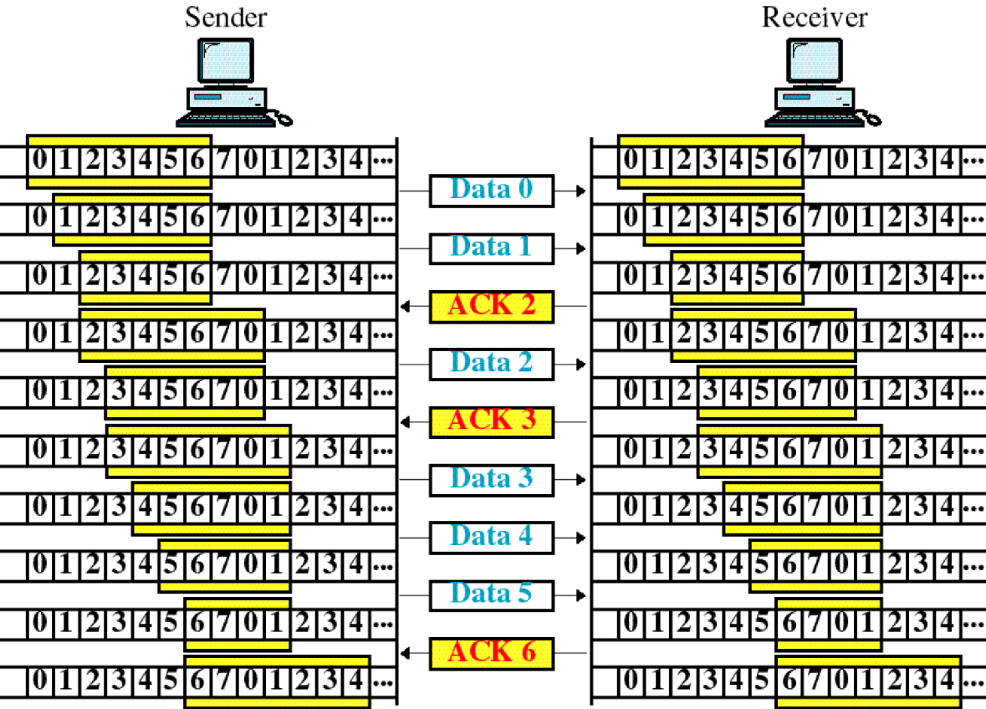
Sliding Window

Slide 15
Automatic Repeat Request (ARQ)
Error correction in data link layer is implemented simply: anytime an error is detected in an exchange, a negative acknowledgement (NAK) is received and specified frames are transmitted- ARQ
Frame is so damaged because of noise and receiver cannot recognize the frame, ARQ allows us to say that the frame has been lost.
Other function of ARQ is retransmission of last frames including lost acknowledgement
Stop and wait is implemented as Stop and Wait ARQ
Sliding window is implemented as sliding window ARQ which comes under two variants: Go-back-n and Selective Reject

Slide 16
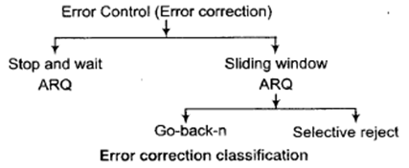

Slide 17
Stop and Wait ARQ
It is an extension of Stop-and –wait flow control to include retransmission of data in case of lost or damaged frames. For retransmission to work, four features are added:
Sending device keeps track of last frames transmitted until it receives an acknowledgment for that frame. Keeping a copy allows the sender to retransmit lost or damaged frames until they are received correctly
For identification purposes both data and ACK frames are numbered alternatively 0 and 1.
If an error is discovered in a data frame, indicating that it has been corrupted in a transit, a NAK frame is returned. When an NAK frame is returned, it resends the frame transmitted after the last acknowledgement irrespective of the number
Sending device is equipped with a timer. If an expected acknowledgment is not received within a allotted time period, sender assumes that last data was lost in transit and send it again

Slide 18
Damaged Frames
when a frame is discovered by the receiver to be an error, it returns an NAK frame and sender retransmits the last frame again.
Let us take for example a sender transmits data frame and one of it is found to be an error.
Sender transmits data frame 0 and receives an acknowledgment ACK1 indicating it is expecting data 1
Now sends data 1 and receives acknowledgment ACK0
Sender now transmits next frame data 0 . Receiver discovers an error in it and returns an NAK
Sender retransmits data 0 again and receives ACK1.

Slide 19
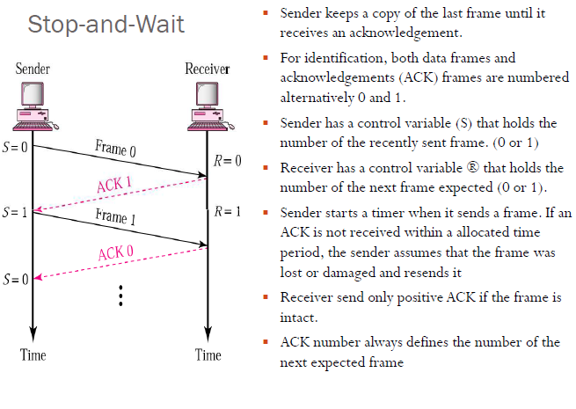
Damaged Frames

Slide 20
ARQ- Lost Frames
Sender is equipped with a timer that starts every time the data frame is transmitted
If the frame never makes it to the receiver , the receiver can neither acknowledge it positively or negatively
Sending devices waits for an ACK or NAK until the timer goes off at which point it tries again
Now it retransmits the data frame and starts the timer once again and wait for an acknowledgement

Slide 21
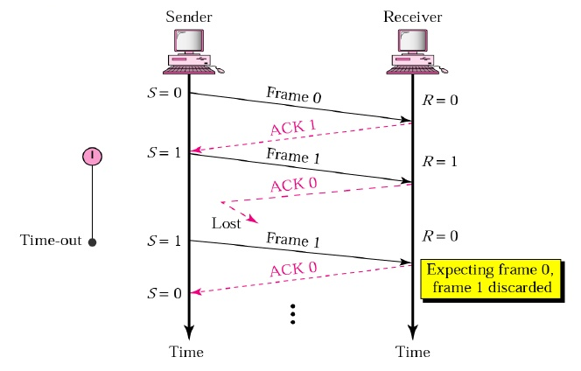

Slide 22
ARQ- Lost Acknowledgement
Here data frame has made it to the receiver has been found as either acceptable or not acceptable
But the ACK or NAK frame returned by receiver has been found to be lost in transit
Now the sending device waits until the timer goes off, then retransmits the data frame again.
Receiver here checks the number of new data frame.
If lost frame was a NAK, the receiver accepts the new copy and returns an ACK for it
If lost frame was an ACK, the receiver recognizes the new copy as a duplicate, acknowledges its receipt, discards the frame and waits for next frame.

Slide 23
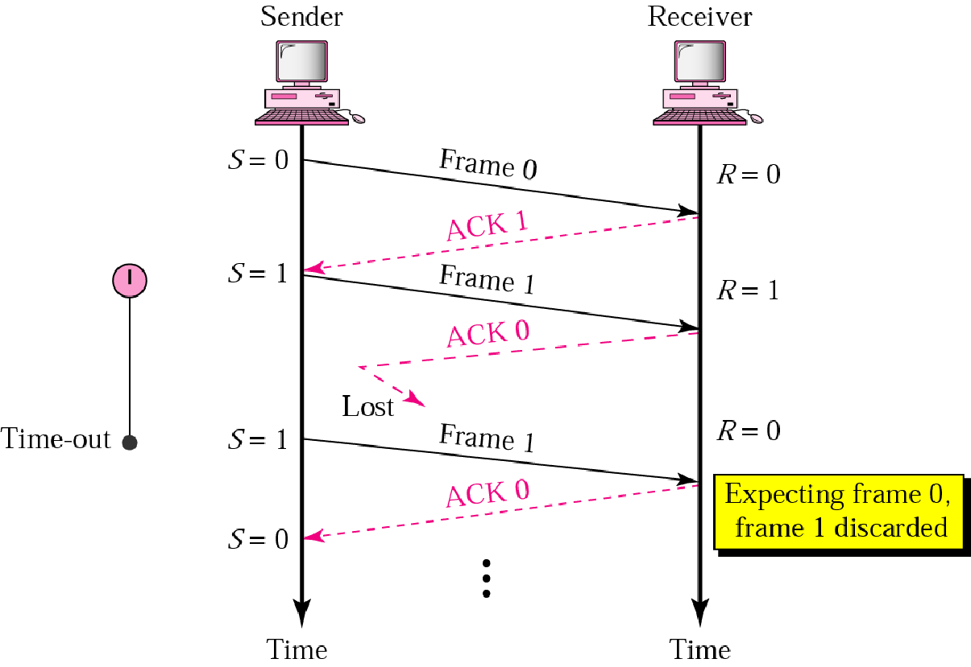
ARQ Lost Acknowledgement

Slide 24
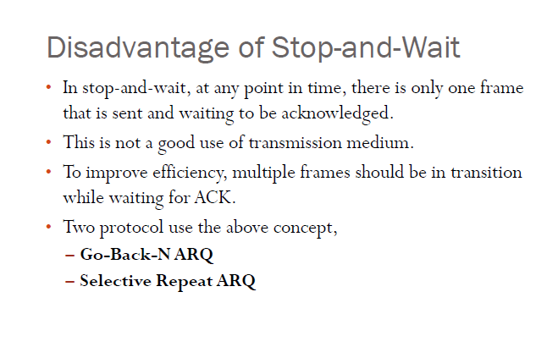

Slide 25
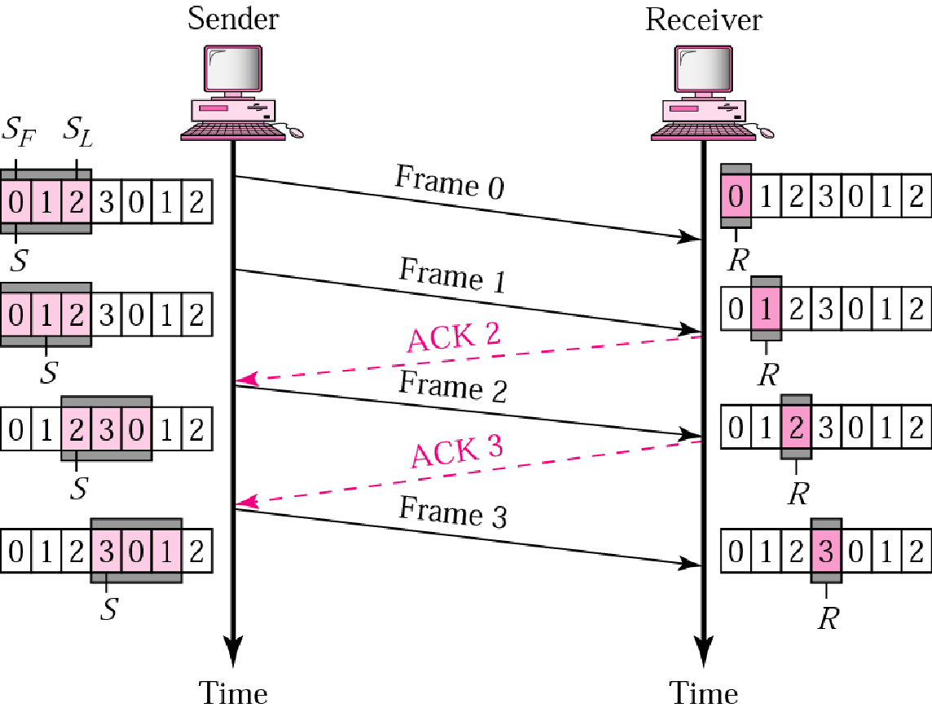
Go Back N ARQ
In Go-back-n ARQ, if a frame is lost or damaged all frames sent since last frame acknowledged are retransmitted
Similarly if an acknowledgment is lost, sliding window waits for the acknowledgement for some specified time. If acknowledgement does not arrive within the time, the data is retransmitted again

Slide 26
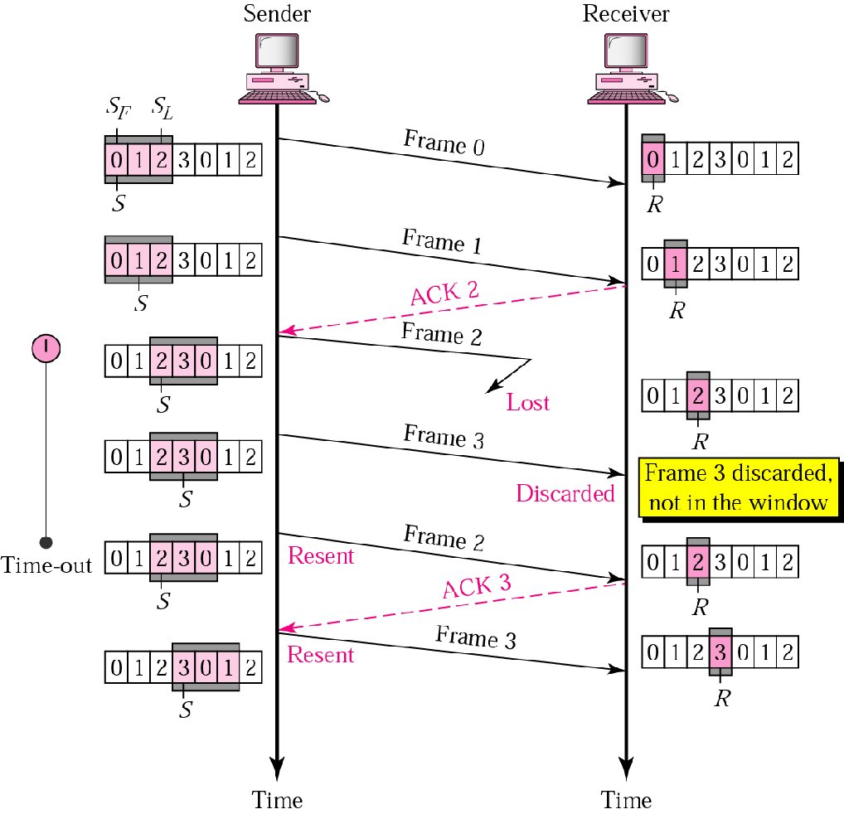
Go-back-n: Damaged Frame

Slide 27
We can see that six frames Frame 0,1,2,3,4,5 are being transmitted before an error is discovered in frame 3.
An ACK3 has been returned by receiver showing that frames 0,1,2 have been received undamaged. The ACK3 has been sent before data 3 has arrived
Data 3 is found to be damaged and so NAK3 has been sent immediately and frames 4 and 5 are discarded
Sending device now retransmits all frames 3,4,5 sent since last acknowledgement and process continues
Receiver discards frames 4 and 5 till it receive data 3 undamaged.

Slide 28
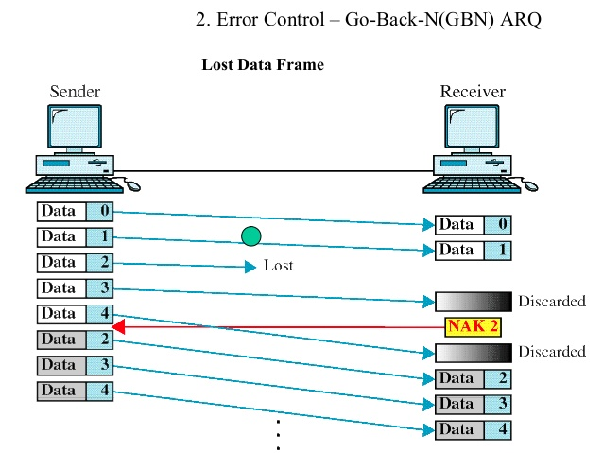
Go-back-n: Lost Data Frame

Slide 29
In this send five data frames 0 through 4 are transfered.
Two data frames data 0 and data 1 arrive intact but data 2 is lost
Next frame expected at the receiver is data 3.
Receiver is now expecting data 2 and so considers data3 to be an error and sends an NAK 2 indicating that 0 and 1 have been accepted but 2 is lost.
Data 4 is transmitted before receiving NAK2 which is out of sequence and is therefore discarded.
Once NAK2 is received, sender now retransmits 2,3,4.

Slide 30
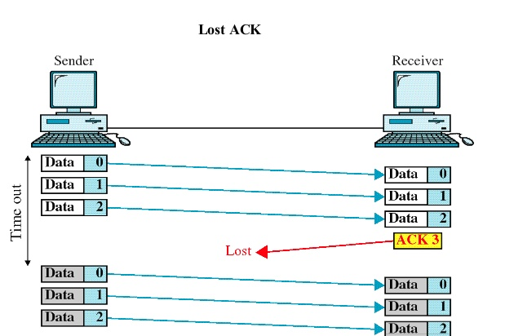
Go-back-n: Lost Acknowledgement

Slide 31
In here the sender have transmitted first three frames 0 through 2.
An acknowledgment ACK3 is now being sent to the sender saying three data frames have been received.
The sender now waits a predetermined amount of time for an acknowledgment of three frames sent.
Once ACK3 is not received within this time, all data frames are retransmitted again.

Slide 32
Selective Reject ARQ
In selective reject ARQ, only specific damaged or lost frame is retransmitted
If a frame is corrupted in transit, NAK is returned and frame is resent out of sequence
Receiving device must be able to sort the frames it has and insert the transmitted frames into proper place in sequence

Slide 33
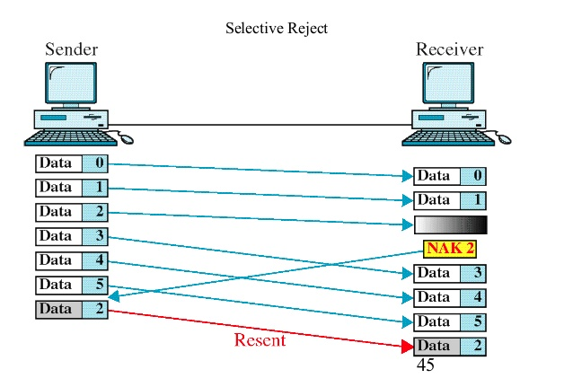

Slide 34
The sender transmits 6 data frames 0 through 5
Once data frames 0 and 1 arrives it is not acknowledged.
Once data 2 is found be damaged, NAK2 is sent which acknowledges that previously unacknowledged data frames that have arrived intact and current data frame is found to be damaged
NAK2 here tells that data 0 and 1 have been accepted and only data 2 has to be resent being damaged unlike go-back-n
Frames received after the damaged frames cannot be acknowledged until the damaged frames have been retransmitted
Receiver accepts data 3,4 5 while waiting for a new copy of data 2.
Once data 2 arrives undamaged, ACK5 can be sent acknowledging new data 2 and original data frames 3,4 and 5.
Logic is needed by the receiver to sort out of sequence transmission and keep track of frames are still missing and which have not yet been acknowledged

Slide 35
Go Back N Vs Selective Reject ARQ
Though retransmitting a specific damaged frame seem to be more efficient than resending all frames
Because of Complexity of storing and sorting required by the receiver and extra logic needed by sender to select specific frames for retransmission, Selective reject ARQ is expensive and not often used
Selective reject ARQ gives better performance but in practice it is usually discarded in favour of go-back-n for simplicity of implementation

Slide 36
Error Detection & Correction

Slide 37
Error Detection & Correction
When an electromagnetic signal flows from one point to another it is subject to interference from heat, magnetism and other forms of electricity
This interference can change the shape of signal
When these signals is carrying binary data, such changes can alter meaning of data resulting in error.
Error when we say can be classified into two types- Single bit and Burst
Single bit error: Error where only one bit of given data unit such as byte, character or packet is changed from 0 to 1.
Burst Error : Error where two or more bits in a given data unit have changed from 1 to 0 or 0 to 1.

Slide 38
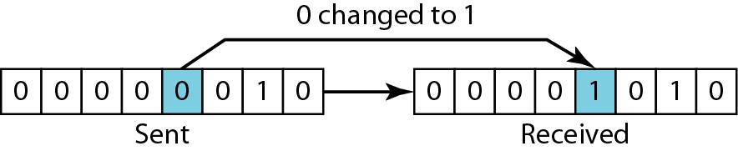
Single Bit Error

Slide 39
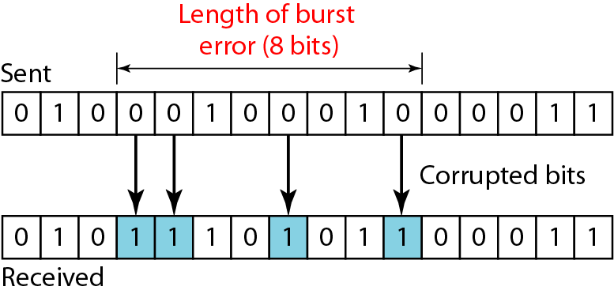
Burst Error

Slide 40
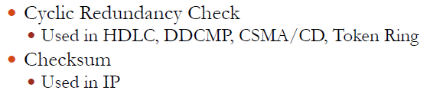
Error Detection Techniques
Once a data is transmitted from sender to receiver, we need to check whether data received is error free or not.
For that we got some Error detection methods that is been used.
Some of them are :
Cyclic Redundancy Check (CRC)
Checksum

Slide 41
Redundancy
Most basic method of error detection is to send every data unit twice
Receiving device would compare both versions of data unit
Any discrepancy would indicate an error and an appropriate correction mechanism could be set in place
This mechanism would be completely accurate but it would be slow.
This would double the transmission time and time it takes to compare bit by bit also must be added.
An improvement of this method is to include EXTRA INFORMATION FOR PURPOSE OF COMPARISON.
This technique is called Redundancy as extra bits are redundant to the information and discarded as soon as the accuracy of information is determined

Slide 42
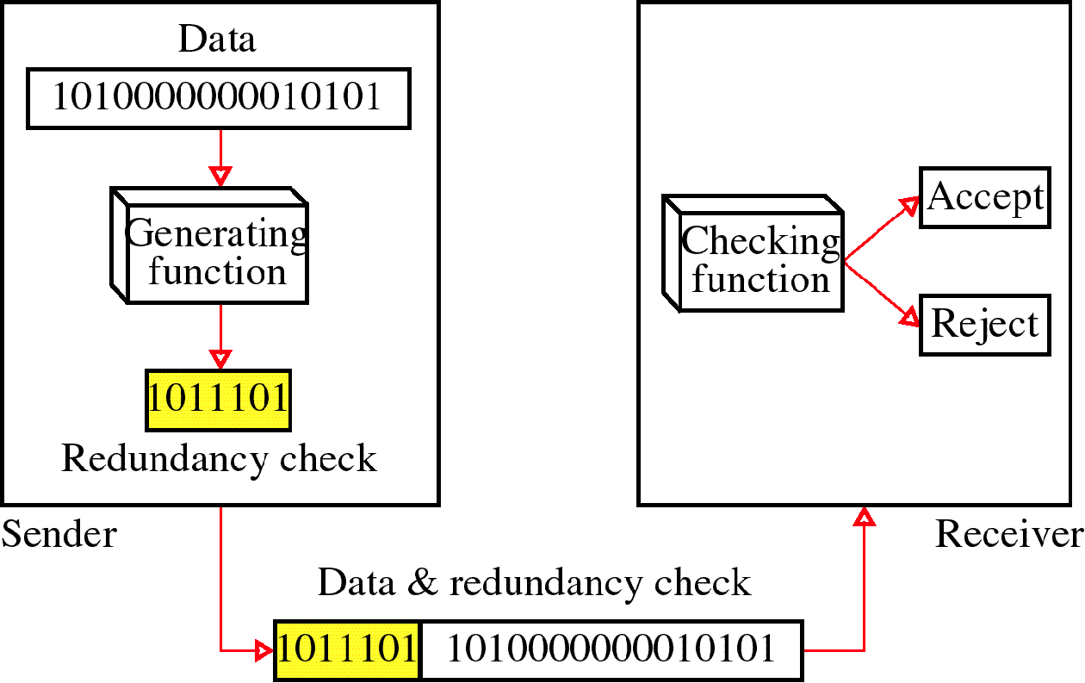

Slide 43
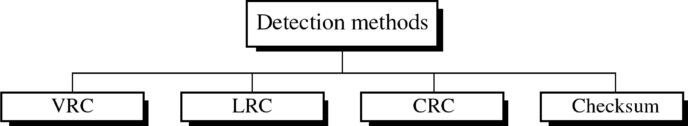
Four types of redundancy checks are used
in data communications

Slide 44
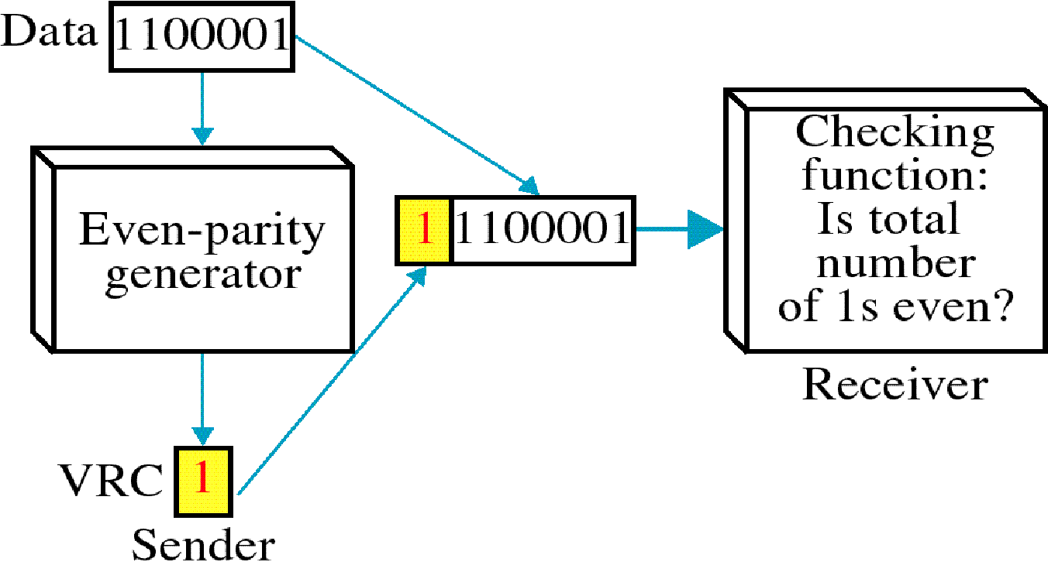
Vertical Redundancy Check - VRC

Slide 45
Performance
It can detect single bit error
It can detect burst errors only if the total number of errors is odd.

Slide 46
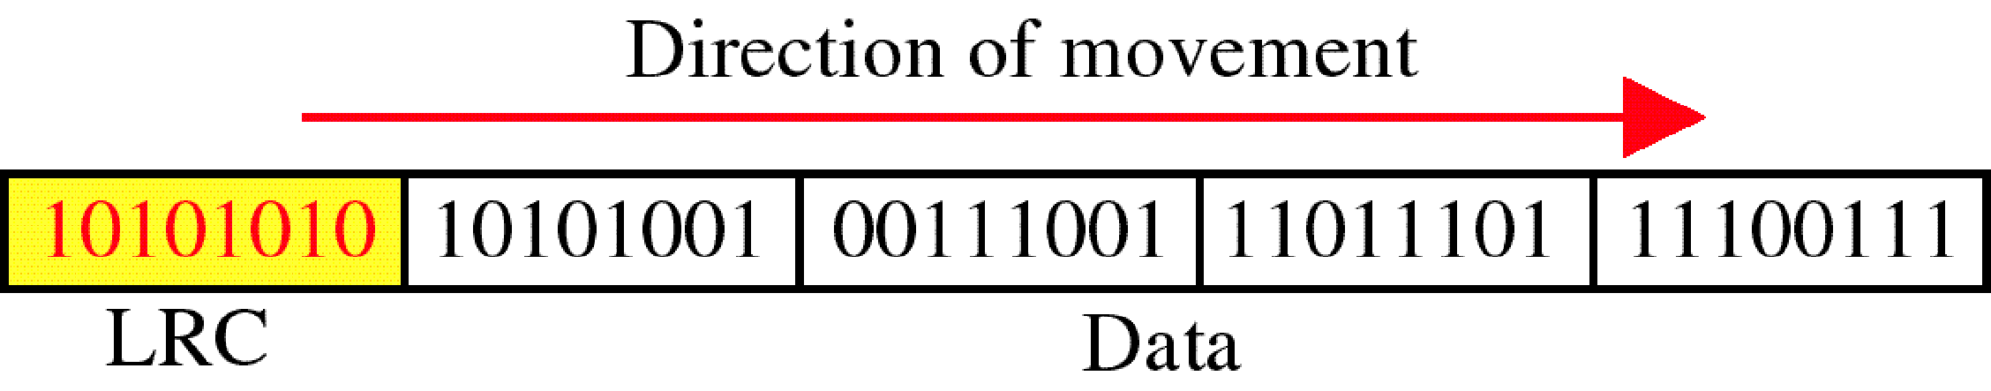
Longitudinal Redundancy Check - LRC

Slide 47
Performance
LCR increases the likelihood of detecting burst errors.
If two bits in one data units are damaged and two bits in exactly the same positions in another data unit are also damaged, the LRC checker will not detect an error.

Slide 48
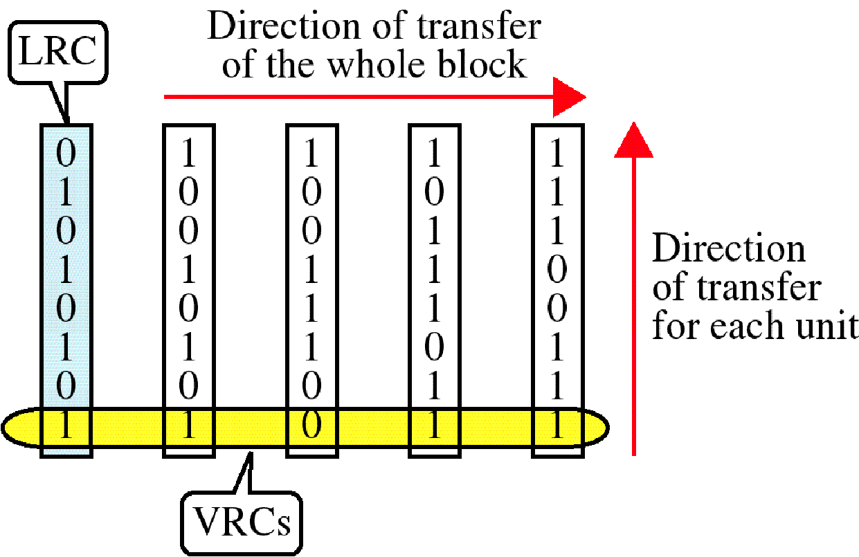
VRC and LRC

Slide 49
Cyclic Redundancy Check (CRC)
The most powerful redundancy checking technique is CRC
This method uses binary division unlike LRC and VRC which uses binary addition.
In CRC instead of adding bits together to achieve a desired parity, Sequence of redundant bits called CRC or CRC remainder is appended to the end of data unit so the resultant data unit becomes exactly divisible by second predetermined number which is the divisor.
At receiver, incoming data unit is divided by the same divisor
If there is no remainder, data unit is assumed to be intact and accepted.
If there is a remainder it means data is been damaged in transit and must be rejected.

Slide 50
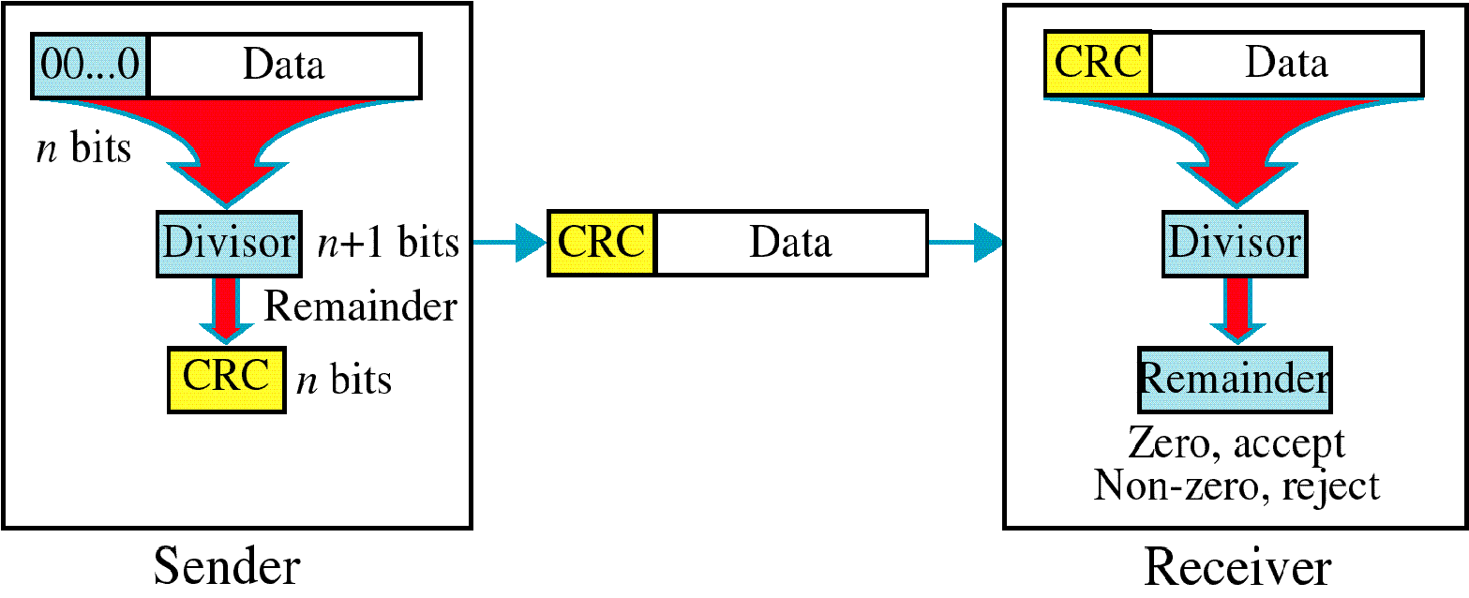
CRC

Slide 51
CRC Algorithm
First a string of 0’s appended to data unit. The number n is less than the number of bits in the divisor which is n+1
Secondly new elongated data is divided by the divisor using a process of modulo 2 binary division
Remainder resulting from division is CRC
CRC of n bits derived which is the remainder is appended to the data unit by replacing the appended 0’s
This data unit arrives at the receiver followed by CRC
Now the receiver divides the data unit by the same divisor to find the remainder
If remainder is 0 it means data is error free and is accepted
If remainder is non zero, data got error and is rejected.

Slide 52
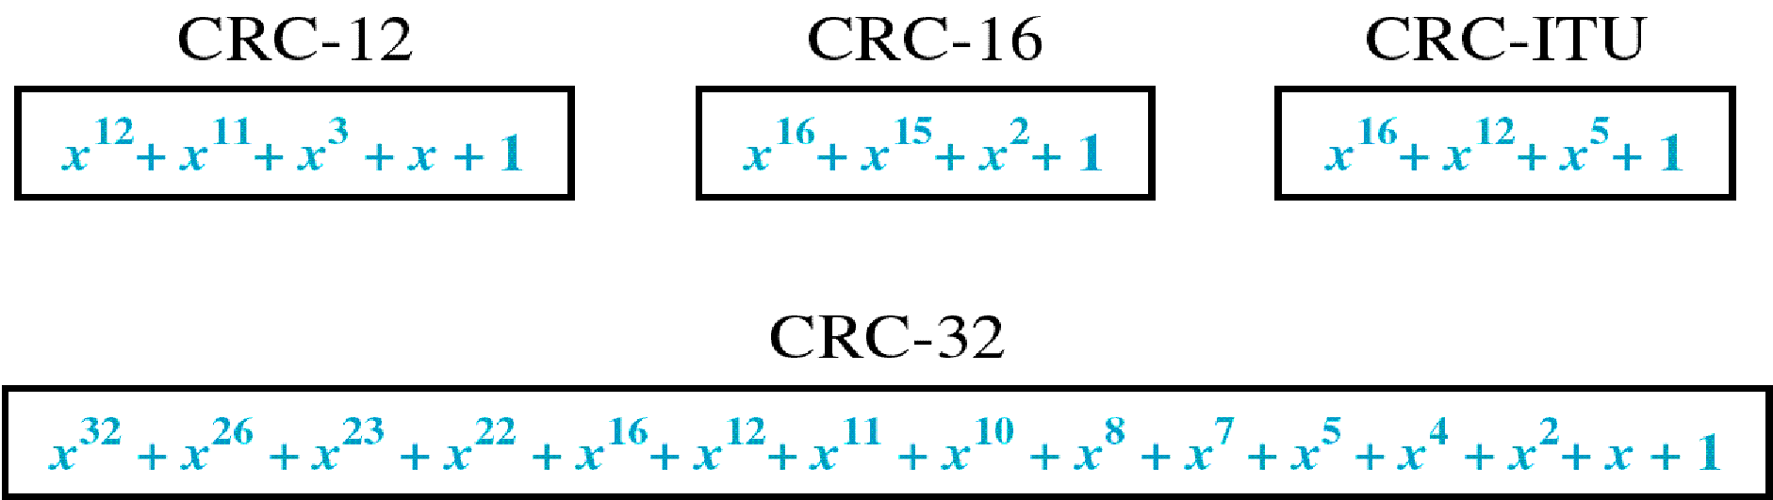
CRC Generator
CRC generator i.e. divisor is often represented as a string of 1s and 0s but as algebraic polynomial
Polynomial is represented as x⁷+ x⁶+ x⁴ +x³ +x +1
Relationship of polynomial to corresponding binary representation is 11011011
Standard CRC polynomials are CRC-12, CRC-16, CRC-ITU-T and CRC-32

Slide 53
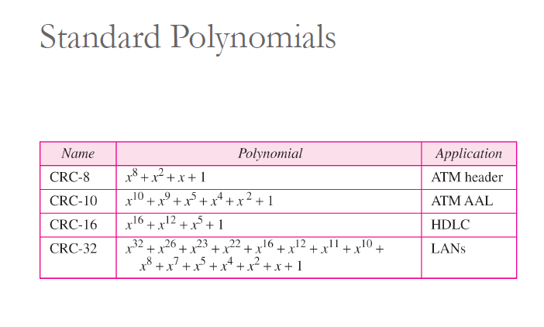

Slide 54
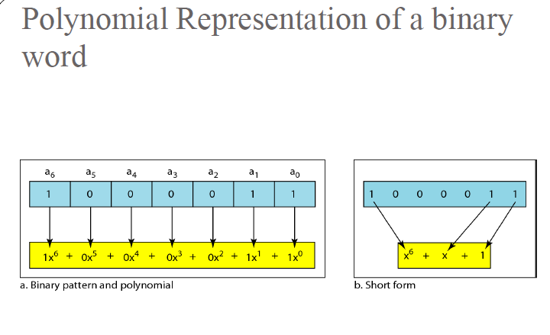

Slide 55
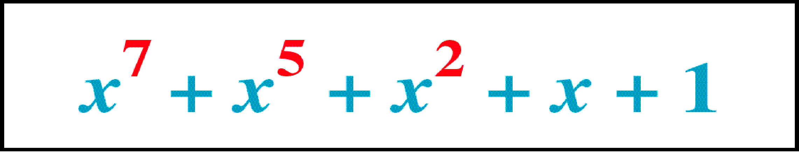
Polynomial

Slide 56
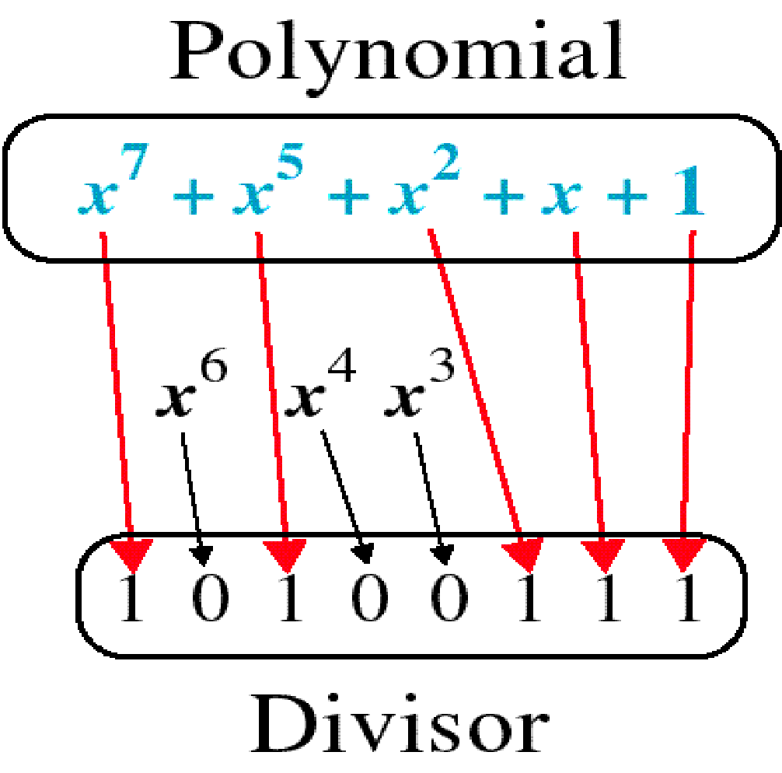
Polynomial and Divisor

Slide 57
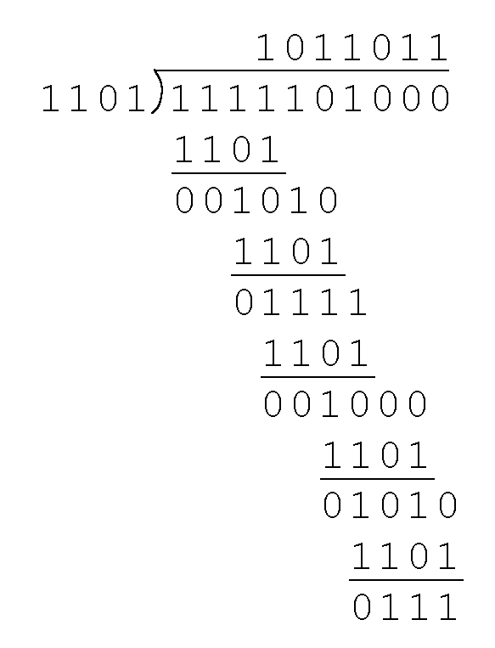
CRC Example
Example: Suppose sender want to transmit the information string: 1111101. The receiver and sender decide to use the (arbitrary) polynomial pattern, 1101 which is the divisor

Slide 58
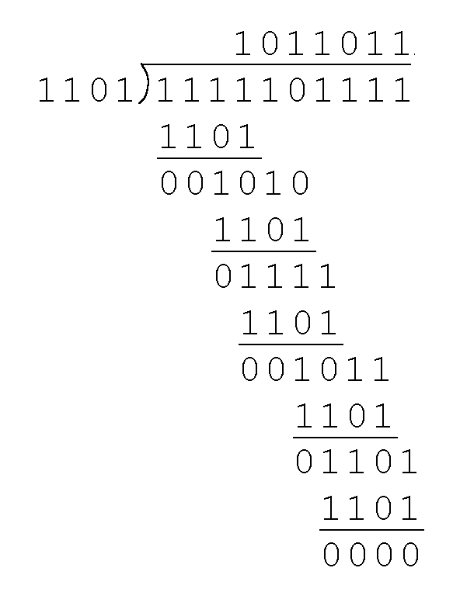
CRC
Remainder is 0111 through modulo 2 division which is added to the data unit by replacing the appended 0’s to get 1111101000+ 0111= 1111101111
Receiver divides the appended data unit by the divisor to see if remainder is zero. If zero it is error free

Slide 59
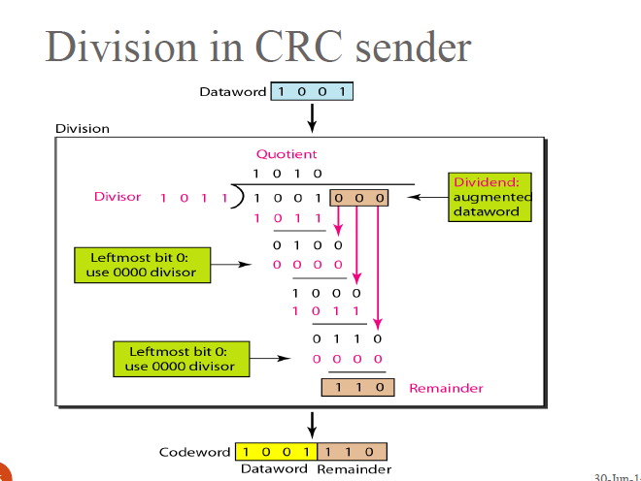

Slide 60
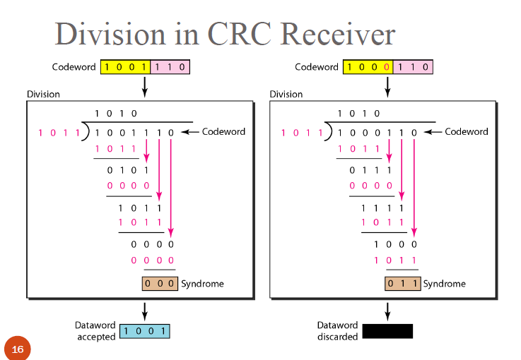

Slide 61
Checksum
Error detection used by higher layer protocols is Checksum
Checksum also is based on the concept of redundancy
Check sum Generator :
In sender, checksum generator subdivides the data unit into equal segments of n bits usually 16
These segments are added together using one’s complement arithmetic so that total is also n bits long
The total is then complemented and appended to the end of the original data unit as redundancy bits called checksum bits

Slide 62
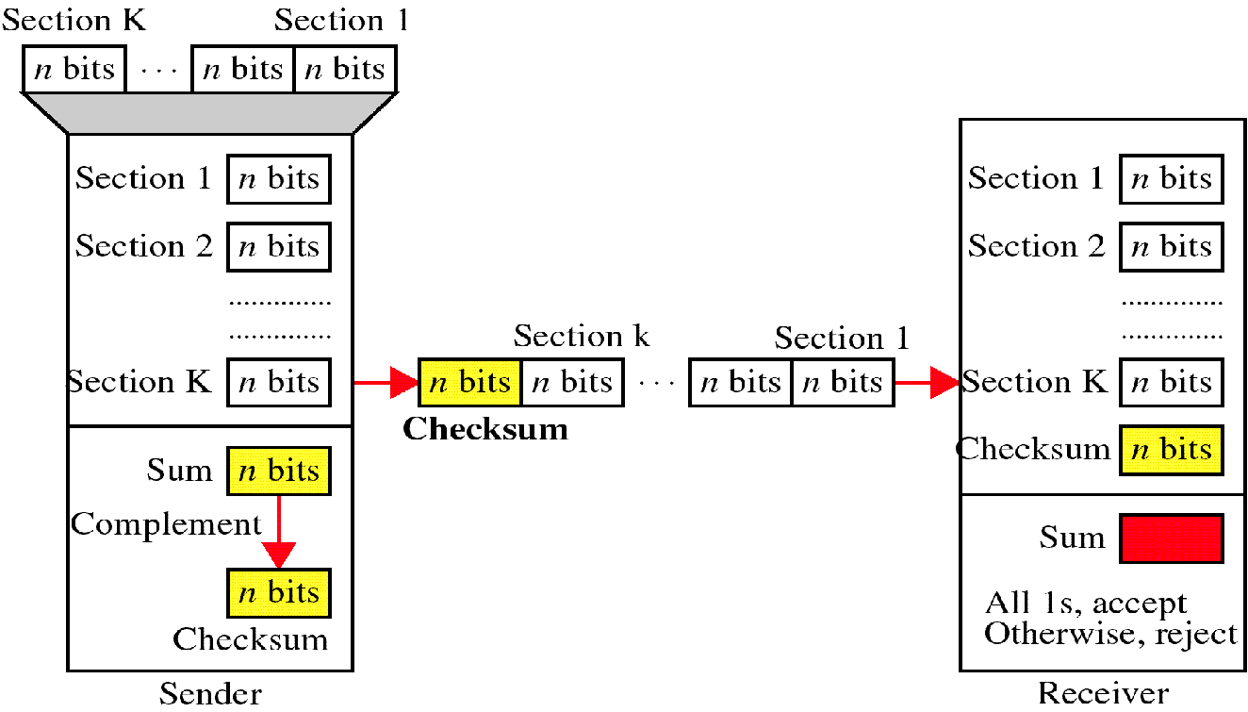
Checksum

Slide 63
At the sender
The unit is divided into k sections, each of n bits.
All sections are added together using one’s complement to get the sum.
The sum is complemented and becomes the checksum.
The checksum is sent with the data

Slide 64
At the Receiver
The unit is divided into k sections, each of n bits.
All sections are added together using one’s complement to get the sum.
The sum is complemented.
If the result is zero, the data are accepted: otherwise, they are rejected.

Slide 65
Performance
The checksum detects all errors involving an odd number of bits.
It detects most errors involving an even number of bits.
If one or more bits of a segment are damaged and the corresponding bit or bits of opposite value in a second segment are also damaged, the sums of those columns will not change and the receiver will not detect a problem.

Slide 66
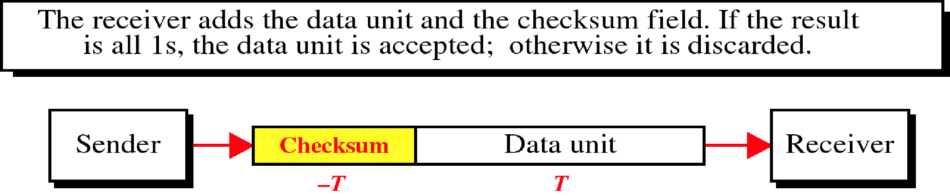
Data Unit and Checksum

Slide 67
Error Correction
Mechanisms covered till now would detect errors but not correct them
One method is when an error is detected by the receiver, the receiver can have the sender retransmit the entire data unit
Another technique is to have error correcting codes by the receiver.
These Error correcting codes are efficient to correct single bit error only
Not efficient in correcting a burst errors.
Based on this we will now see one of the famous Error correcting code- Hamming Code

Slide 68
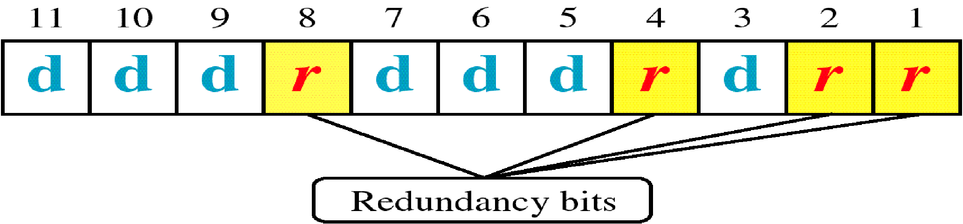
Hamming Code

Slide 69
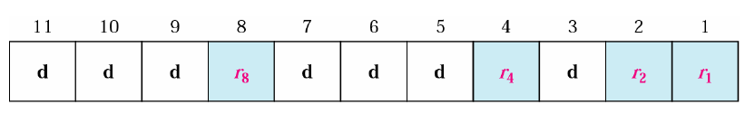
Error Correction

Slide 70
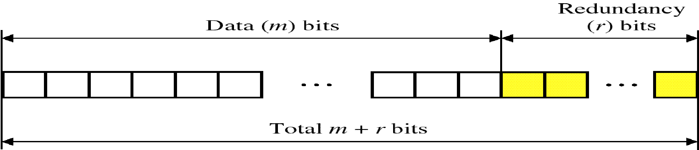
Hamming Code
Technique developed by R.W. Hamming
Applied to data units of any length and uses the relation ship between data and redundancy as 2^{r}>= m+r+1 where m is the data unit, r redundancy bit.
For example a 7 bit data would need 2⁴>= 7+4+1
Redundancy bits are placed in positions which are powers of 2
Position of redundancy bits in hamming code for m +r bits i.e 7+4= 11 bit data

Slide 71
Example: Let us say data is 7 bit word which is 1001101
We would now apply hamming code technique to see which bit got error.
Steps are:
Determine the number of redundancy/ check bits which is given as 2⁴>= 7+4+1. so we used four parity bits
Number the n bits left to right
1 0 0 r₈ 1 1 0 r₄ 1 r₂ r₁
We got to now calculate the combination of the four r values for a seven bit data sequence
For that we first write all bit positions as sums of those numbers that are powers of 2
1=1, 2=2, 3= 1+2, 4=4, 5= 1+4, 6= 2+4, 7= 1+2+4, 8=8, 9= 1+8, 10= 2+8, 11= 1+2+8
so now r₁= 1,3, 5, 7, 9, 11; r₂= 2,3,6,7,10,11; r₄= 4,5, 6,7; r₈= 8,9,10,11

Slide 72
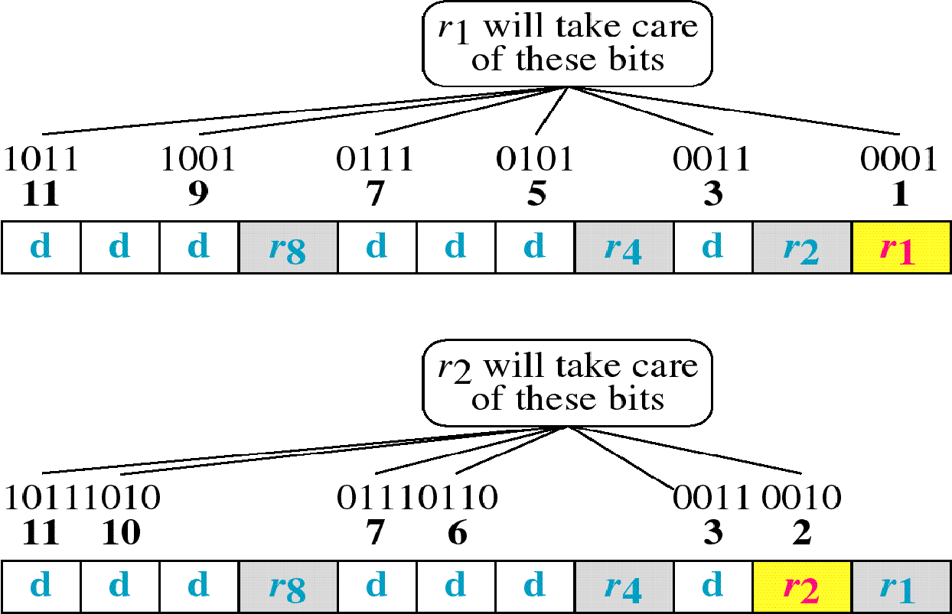

Slide 73
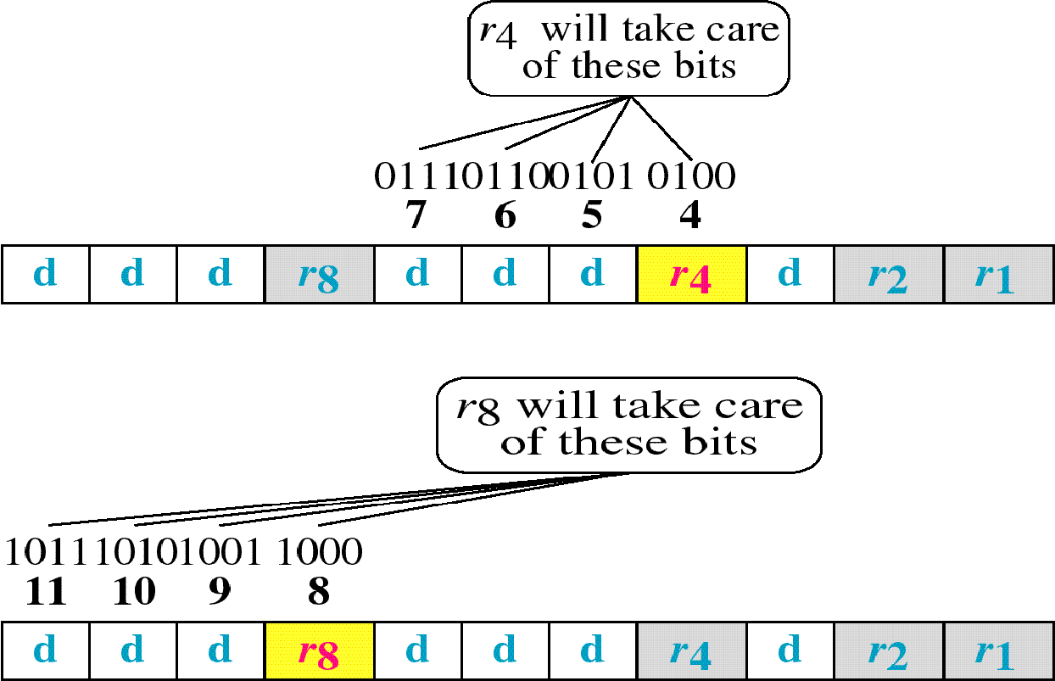

Slide 74
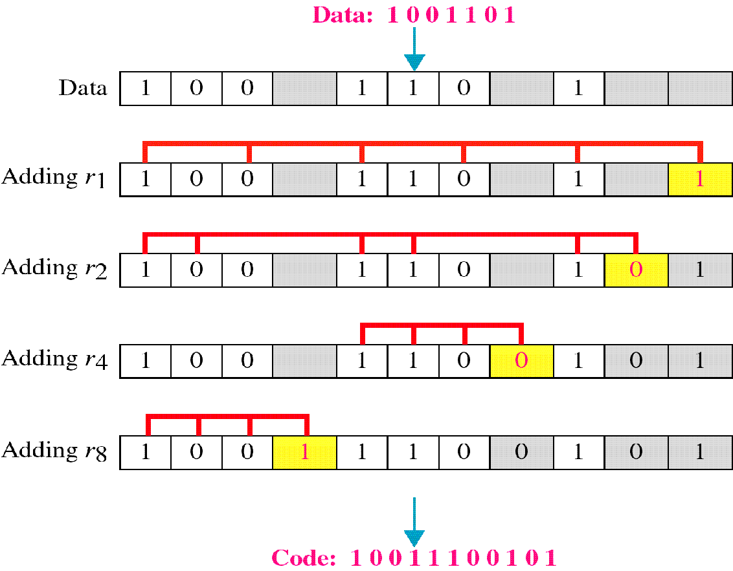
Example

Slide 75
Hamming Code
Now we write the parity bit for each of the r value . For example parity bit of r1 is calculated to provide even parity of combination 3,5,7,9,11 which sees odd number of 1’s and we add 1 to r1. Similarly we perform for r₂, r₄ and r₈ ending in the final code as 10011100101
Now the code is sent to the receiver say 10010100101and receiver calculates the four new VRC’s using the same set of bits used by sender plus relevant parity bits (r1,r2,r4, r8) for each set
Then receiver reassembles new parity values into a binary number in order of r position (r8, r4, r2, r1) which results in 0111.
That is bit 7 is the error and is corrected to give 10010100101

Slide 76
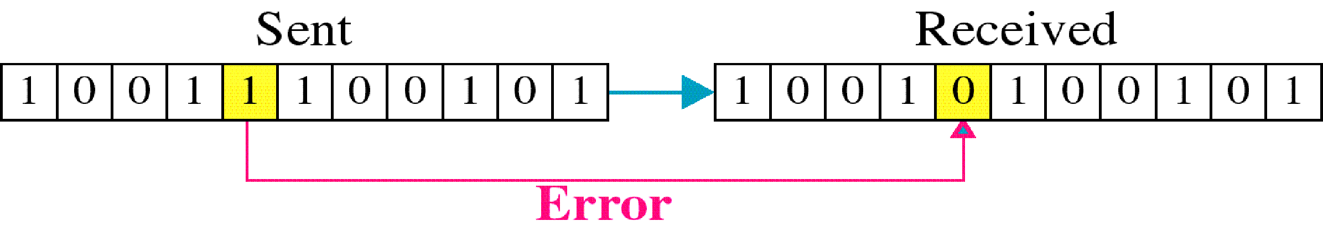
Single-bit error

Slide 77
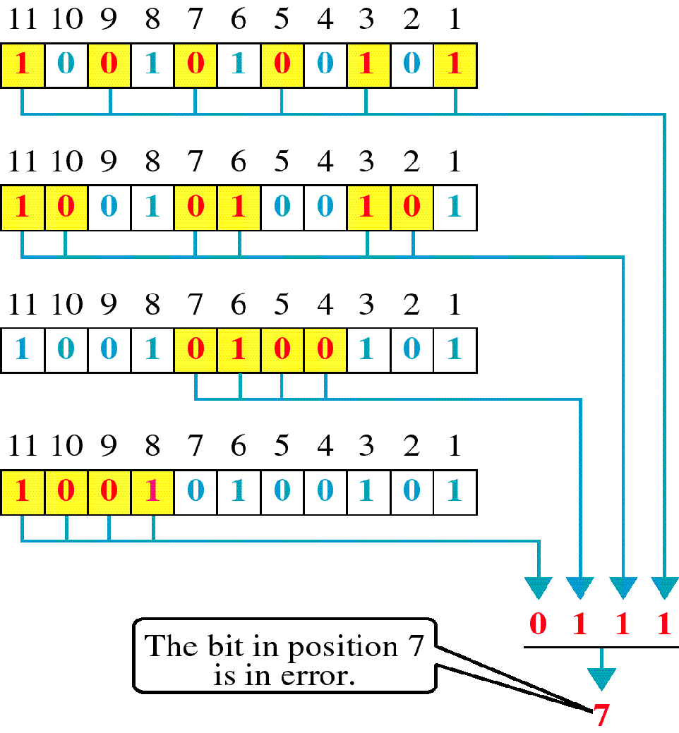
Error
Detection

Slide 78
Medium Access control Methods –CSMA, CSMA/CA & /CD

Slide 79
MULTIPLE ACCESS PROTOCOLS
When nodes or stations are connected and use a common link, called a multipoint or broadcast link, we need a multiple-access protocol to coordinate access to the link.
The problem of controlling the access to the medium is similar to the rules of speaking in an assembly.
The procedures guarantee that the right to speak is upheld and ensure that
Two people do not speak at the same time,
Do not interrupt each other,
Do not monopolize the discussion, and so on.

Slide 80
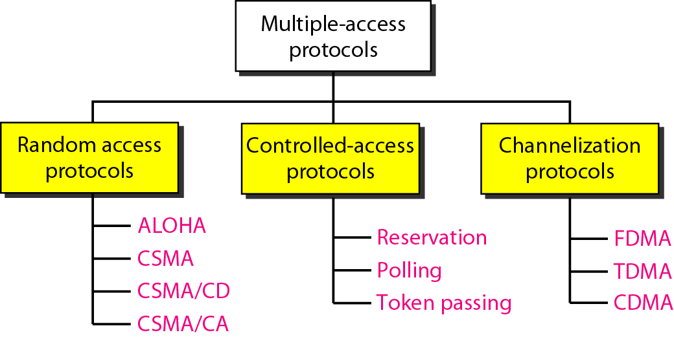
Taxonomy of multiple-access protocols discussed in this chapter

Slide 81
Random Access Methods
In random access or contention methods, no station is superior to another station and none is assigned the control over another.
No station permits, or does not permit, another station to send.
At each instance, a station that has data to send uses a procedure defined by the protocol to make a decision on whether or not to send.
This procedure depends on the state of the medium whether it is idle or busy.

Slide 82
Reason for Random Access or Contention
Two features give this methods its name
No scheduled time for a station to transmit and Transmission is random among the stations. So these methods are called random access.
No specific rules as which station should send next . Stations compete with one another to access the medium. So called Contention methods

Slide 83
Procedure followed by Station for Random Access
Each station has the right to the medium without being controlled by another station
If more than one station tries to send, there is an access conflict- collision and frames will be either destroyed or modified
To avoid access conflict or to resolve it when it happens, each station follows a procedure which answers the following queries:
When can station access the medium
What can station do if medium is busy
How can the station determine the success or failure of the transmission
What can station do if there is an access conflict

Slide 84
Random access methods we would be studying have evolved from a very interesting protocol known as ALOHA which uses a very simple procedure called Multiple Access (MA)
Method was later improved with the addition of procedure that forces the station to sense the medium before transmitting. This was called Carrier Sense Multiple Access
This later evolved into two parallel methods
Carrier Sense Multiple Access (CSMA)
Carrier Sense Multiple Access with Collision Detection and Avoidance (CSMA/CD) & (CSMA/CA)
84

Slide 85
CSMA protocol
To minimize the chance of collisions and increase the performance, the CSMA (Carrier Sense Multiple Access) method was developed
CSMA requires that each station first listen to the medium before sending
CSMA can reduce the possibility of collision but cannot eliminate it.
Possibility of collisions still exists due to propagation delay
Two CSMA protocols developed were: Persistent and non-persistent

Slide 86
Vulnerable time in CSMA
Vulnerable time in CSMA is the propagation time which is T_{p} i.e. time needed for a signal to propagated from one end to other.
When a station sends a frame and any other station sends a frame during this time, a collision will result.
But if the first bit of frame reaches the end of medium, every station will have heard the bit and will refrain from sending.
Figure in next slide shows the worst case where a frame sent by station A at time t₁ reaches the rightmost station D at time t₁+ T_{p}

Slide 87
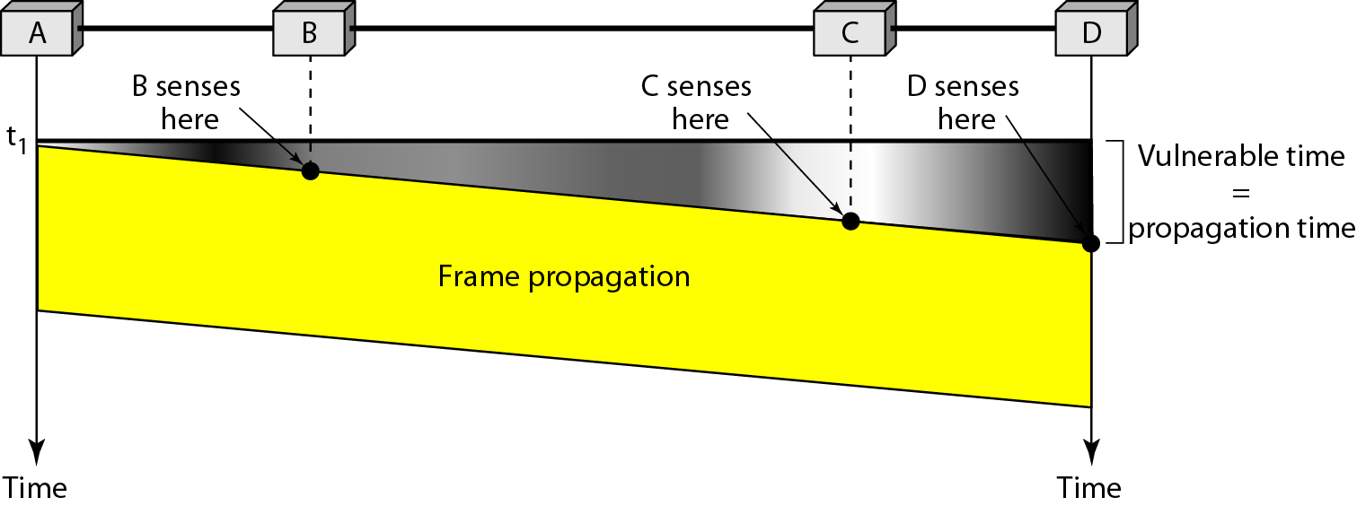
Vulnerable Time in CSMA

Slide 88
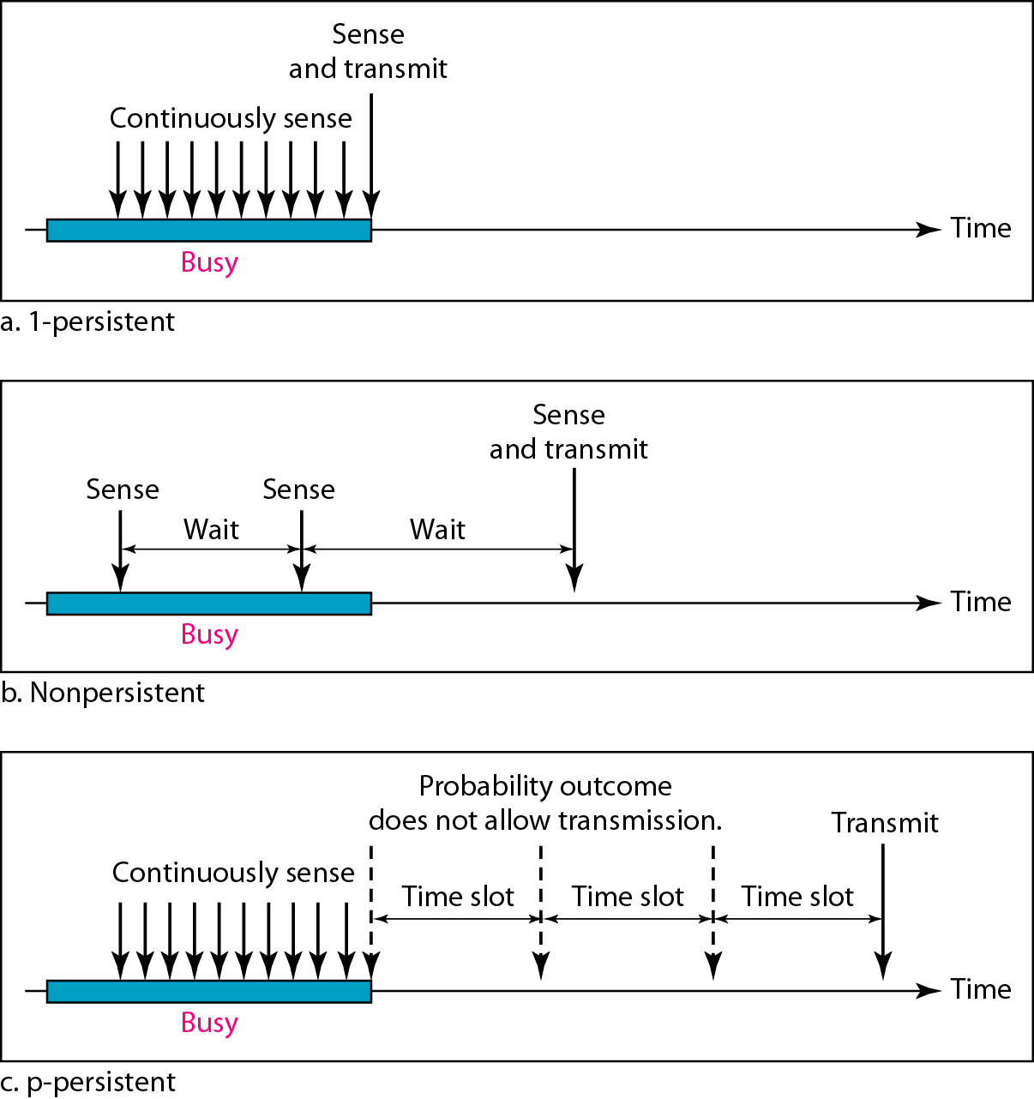
Behavior of three persistence methods

Slide 89
1-Persistent CSMA protocol
When station finds the medium is idle, it sends its frame immediately with a probability of 1.
If the medium is busy it waits until it becomes idle and sends its frame with a probability of 1.
Method has highest chance of collisions because two or more stations may find the line idle and send their frames immediately.

Slide 90
Non-persistent CSMA protocol
Station senses a channel
If channel is idle, station begins transmitting
If channel is busy, station does not continually wait for accessing the channel
Instead it waits a random period of time and then repeats algorithm again- Exponential Back off
This method reduces the collision as it is unlikely two or more stations will wait the same amount of time and retry to send simultaneously

Slide 91
p-persistent CSMA protocol
This method is used if channel has time slots with slot duration equal to or greater than maximum propagation time
p-persistence approach combines the advantages of other two methods.
Reduces the chances of collision and improves efficiency
Here once the station finds the line is idle, it follows these steps:
i With probability p, station sends its frame
ii With probability q= 1-p, station waits for beginning of the next time slot and checks the line again
a. If line is idle, it goes to step i
b. If line is busy, it acts as collision has occurred and uses back off procedure.

Slide 92
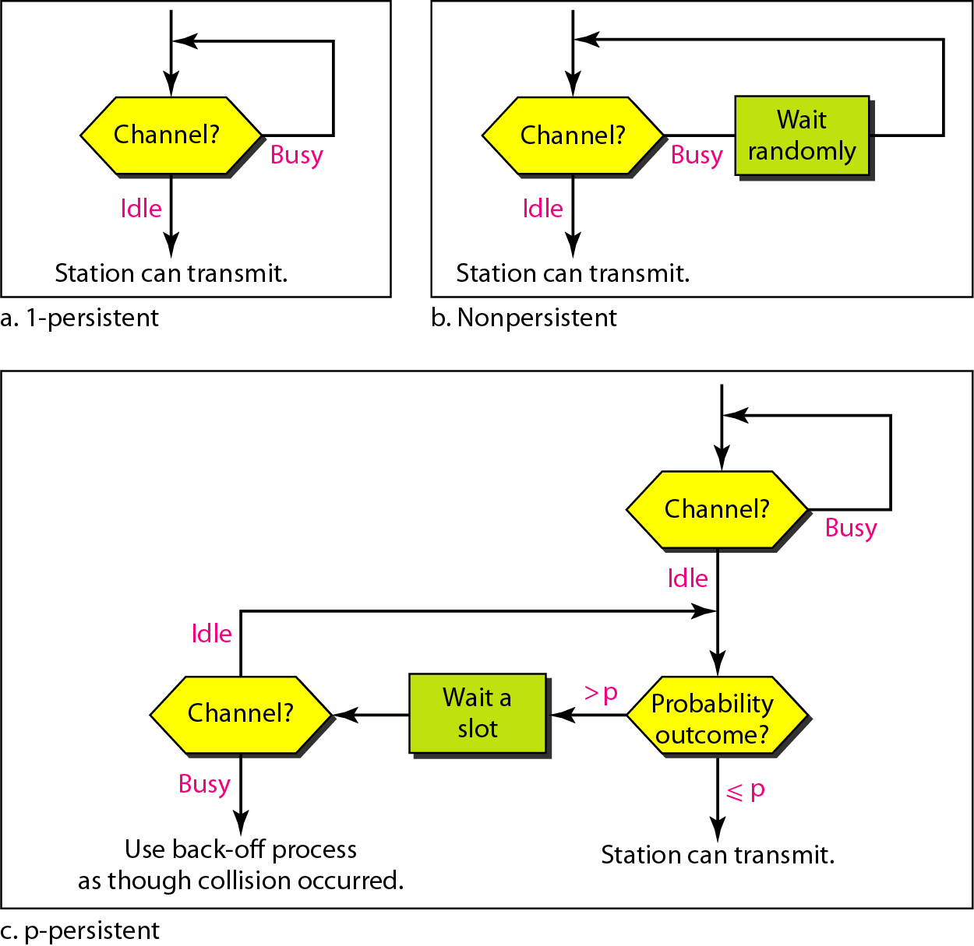
Flow Diagram of three persistence methods

Slide 93
Carrier Sense Multiple Access with Collision Detection (CSMA/CD)
CSMA method does not specify the procedure following a collision
CSMA/CD augments the algorithm to handle collision
In this method, a station monitors the medium after it sends a frame to see if the transmission was successful
If successful, the station is finished
If not, frame is sent again.
We can better understand CSMA/CD with the diagram in next slide.

Slide 94

Collision of first bit in CSMA/CD

Slide 95
At time t1, Station A has executed the persistence procedure and starts sending the bits of its frame
At time t2 station C has not yet sensed the first bit sent by A .
Station C executes its persistence procedure and starts sending bits in frame which propagates to both left and right
Collision occurs after time t2.
Station C detects a collision at time t3
when it receives first bit of A’s frame.
Station C aborts its transmission
Station A detects collision at time t4 when it receives first bit of C’s frame; it also aborts its transmission immediately.
We see that A transmits for a duration of t₄-t_{1;} C transmits for duration of t₃-t_{2.}
At time t₄ transmission of A’s frame though incomplete is aborted; time t₃ transmission of C’s frame though incomplete is aborted

Slide 96

Collision and abortion in CSMA/CD

Slide 97
Minimum Frame size for CSMA/CD
For CSMA/CD we need restriction of the frame size
Before sending the last bit of frame, sending station must detect collision , if any must abort the transmission
Reason for this is a station once sent the entire frame does not monitor the line for collision detection
So, Frame Transmission time T_{fr} = 2 * T_{p}
If two stations involved in collision are maximum distance apart, signals from first takes time T_{p} to reach the second and effect of collision takes another time T_{p} to reach the first.
Requirement is first station should still be transmitting after 2 T_{p}

Slide 98

Flow Diagram for CSMA/CD

Slide 99
Example
A network using CSMA/CD has a bandwidth of 10 Mbps. If the maximum propagation time (including the delays in the devices and ignoring the time needed to send a jamming signal, as we see later) is 25.6 μs, what is the minimum size of the frame?
Solution
The frame transmission time is T_{fr} = 2 × T_{p} = 51.2 μs. This means, in the worst case, a station needs to transmit for a period of 51.2 μs to detect the collision. The minimum size of the frame is 10 Mbps × 51.2 μs = 512 bits or 64 bytes. This is actually the minimum size of the frame for Standard Ethernet.

Slide 100
HDLC and PPP

Slide 101

The Data Link Layer in the Internet
A home personal computer acting as an internet host.
Technology like Ethernet cannot provide “high-level” functionality like connection management and parameter negotiation

Slide 102
Point to Point Data Link Control
One sender, one receiver, one link: easier than broadcast link:
No Media Access Control
No need for explicit MAC addressing
E.g., dialup link, ISDN line
Popular point-to-point and high-level DLC protocols:
PPP (point-to-point protocol)
HDLC: High level data link control (Data link used to be considered “high layer” in protocol stack). HDLC is also used in multi-point links (one station many receivers)
These protocols can often be run over other data link technologies providing best of both worlds
E.g., PPPoE, HDLC encapsulation by Ethernet

Slide 103
PPP Design Requirements [RFC 1557]
Functionality : (similar to link layer services + extra management functions)
Packet framing - encapsulation of network-layer datagram in data link frame
Multi-protocol - carry network layer data of any network layer protocol (not just IP) at same time ability to demultiplex upwards
Bit transparency - must carry any bit pattern in the data field (even if underlying channel can't)
Error detection - not correction

Slide 104
PPP Design Requirements (cont.)
The extra stuff:
Connection liveness: detect, signal link failure to network layer
Network layer address negotiation: endpoint can learn/configure each other’s network address and other characteristics.
Authentication: who are you (or at least whose account do I bill for your dial-in time?)
This information is used by traffic management software to control bandwidth to individual subscribers
Management features: loopback detection

Slide 105
PPP non-requirements
No error correction/recovery
(modems do one layer FEC, one layer packetization + retransmission “under the covers” anyway; other technologies are pretty reliable)
No flow control
Out of order delivery OK
Error recovery, flow control, data re-ordering
all relegated to higher layers!

Slide 106

PPP Data Frame
Flag: delimiter (framing)
Address: ignored. (historical)
Control: ignored. (historical)
Protocol: upper layer protocol to which frame delivered (e.g., PPP-LCP, IP, IPCP, etc)

Slide 107
PPP Data Frame
info: upper layer data being carried
check: cyclic redundancy check for error detection

Slide 108

Byte Stuffing
flag byte
pattern
in data
to send
flag byte pattern plus
stuffed byte in transmitted data

Slide 109

PPP Data Control Protocol
Before exchanging network-layer data, data link peers must
Configure PPP link (max. frame length, authentication)
Learn/configure network
layer information
for IP: carry IP Control Protocol (IPCP) msgs (protocol field: 8021) to configure/learn IP address

Slide 110
Where does PPP get used?
Dial-up – PPP over async serial, over modem
ADSL – PPP over Ethernet
Backbone – Packet over SONET (POS)
Why?
Framing (dialup, POS)
Efficiency (POS)
Authentication, address negotiation (PPPoE)

Slide 111
High-Level Data Link Control (HDLC)
HDLC was defined by ISO for use on both point-to-point and multipoint data links.
It supports full-duplex communication
Other similar protocols are
Synchronous Data Link Control (SDLC) by IBM
Advanced Data Communication Control Procedure (ADCCP) by ANSI
Link Access Procedure, Balanced (LAP-B) by CCITT, as part of its X.25 packet-switched network standard

Slide 112
HDLC Overview
Broadly HDLC features are as follows:
Reliable protocol
selective repeat or go-back-N
Full-duplex communication
receive and transmit at the same time
Bit-oriented protocol
use bits to stuff flags occurring in data
Flow control
adjust window size based on receiver capability
Uses physical layer clocking and synchronization to send and receive frames

Slide 113
HDLC Overview
Defines three types of stations
Primary
Secondary
Combined
Defines three types of data transfer mode
Normal Response mode
Asynchronous Response mode
Asynchronous Balanced mode
Three types of frames
Unnumbered
information
Supervisory

Slide 114
HDLC
The three stations are :
Primary station
Has the responsibility of controlling the operation of data flow the link.
Handles error recovery
Frames issued by the primary station are called commands.
Secondary station,
Operates under the control of the primary station.
Frames issued by a secondary station are called responses.
The primary station maintains a separate logical link with each secondary station.
Combined station,
Acts as both as primary and secondary station.
Does not rely on other for sending data

Slide 115
HDLC
Unbalanced Mode
Commands
Primary
Responses
Secondary
Secondary
Balanced mode
Combined
Combined
commands/Responses

Slide 116
HDLC
The three modes of data transfer operations are
Normal Response Mode (NRM)
Mainly used in terminal-mainframe networks. In this case,
Secondaries (terminals) can only transmit when specifically instructed by the primary station in response to a polling
Unbalanced configuration, good for multi-point links
Asynchronous Response Mode (ARM)
Same as NRM except that the secondaries can initiate transmissions without direct polling from the primary station
Reduces overhead as no frames need to be sent to allow secondary nodes to transmit
Transmission proceeds when channel is detected idle , used mostly in point-to-point-links
Asynchronous Balanced Mode (ABM)
Mainly used in point-to-point links, for communication between combined stations

Slide 117
Non-operational Modes
Normal Disconnected Mode
Asynchronous Disconnected Mode
Both the above modes mean that the secondary node is logically disconnected from the primary node
Initialization Mode
A node negotiates transmission parameters with the other node E.g., flow control information
Parameters negotiated in this mode are used during any of the data transfer modes

Slide 118

Data Link Control HDLC frame structure
(a) Frame
Format
(b) Control
field
format
Notes:
2

Slide 119

Data Link Control HDLC frame structure
(c) Extended address field
(d) Extended control field
Notes:
2

Slide 120
HDLC
Flag: 01111110- start and ending delimiter. Bits are stuffed for flags in data frames
FCS: 16-bit CRC using generating polynomial
G(x) = x¹⁶ + x¹² + x⁵ + 1
Address field:
mainly used in multidrop link configuration, and not used in point-to-point
In unbalanced configuration, every secondary is assigned a unique address. Contains address of secondary station in both command and response frames
In balanced mode, command frame has destination address and response frame has sending node’s address
Group addresses are also possible. E.g., One command sent to all the secondaries
In I-frames, N(s) is the sequence number of the frame being sent, and R(s) is the sequence number of the frame being expected.
The P/F bit, known as the poll/final bit, is used with different meaning in different contexts.
It is used to indicate polling, to indicate the final I-frame, etc

Slide 121
HDLC
There are three different classes of frames used in HDLC
Unnumbered frames, used in link setup and disconnection, and hence do not contain ACK.
Information frames, which carry actual information. Such frames can piggyback ACK in case of ABM
Supervisory frames, which are used for error and flow control purposes and hence contain send and receive sequence numbers

Slide 122
HDLC
There are four different supervisory frames
SS=00, Receiver Ready (RR), and N(R) ACKs all frames received up to and including the one with sequence number N(R) - 1
SS=10, Receiver Not Ready (RNR), and N(R) has the same meaning as above
SS=01, Reject; all frames with sequence number N(R) or higher are rejected, which in turns ACKs frames with sequence number N(R) -1 or lower.
SS=11, Selective Reject; the receive rejects the frame with sequence number N(R)

Slide 123
HDLC
The unnumbered frames can be grouped into the following categories:
Mode-setting commands and responses
Recovery commends and responses
Miscellaneous commands and responses

Slide 124
Review of Link Layer
Services
Framing
Error control
Reliability
Connection management
Medium access control
Switching
Protocols, Standards
Ethernet
Token Ring
FDDI
Wireless
PPP
HDLC

